Slide 1


Slide 2
Building strong wall of protection for your container & pods
Sagar Utekar
Site Reliability Engineer @VMWare

Slide 3

About me
Working as MTS3 Site Reliability Engineer at VMWare Software India PVT. LTD.
DOCKER CNCF PUNE Community Leader
Open-Source Enthusiast, A firm believer in the power of community education.
Google Summer Of Code Admin since 2018, Mentor, Mentee 2022 @PEcAn Project
GSoD, GSSoC, Github Externship, SIH mentor
CKS | CKA | CKAD | EX180 | Prometheus | Terraform Certified | EX180 | EX294 | EX200
Mentored 5000+ students & professionals across India for career guidance, Job Search, Open Source, Cloud Native #GetFitWithSagar

Slide 4

AGENDA
Containers challenges
The shared responsibility model
Kubernetes security best practices
Observability
Resources

Slide 5
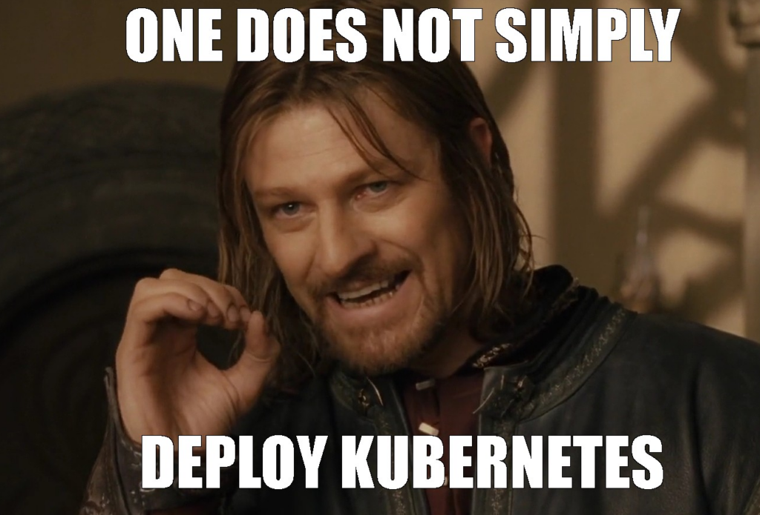
Container Challenges

Slide 6
Container challenges
Processes running on a shared host, often share a network interface
Isolation implemented by Linux namespaces and cgroups
Immutable, Short lifespans
Traditional / legacy security software is rarely container aware
Firewalls
Intrusion detection system (IDS) / Intrusion prevention system (IPS)
Data loss prevention (DLP)
Forensics
Detecting and restricting container image sources and content
Preventing malicious artifacts from getting into container images

Slide 7
The shared responsibility model

Slide 8
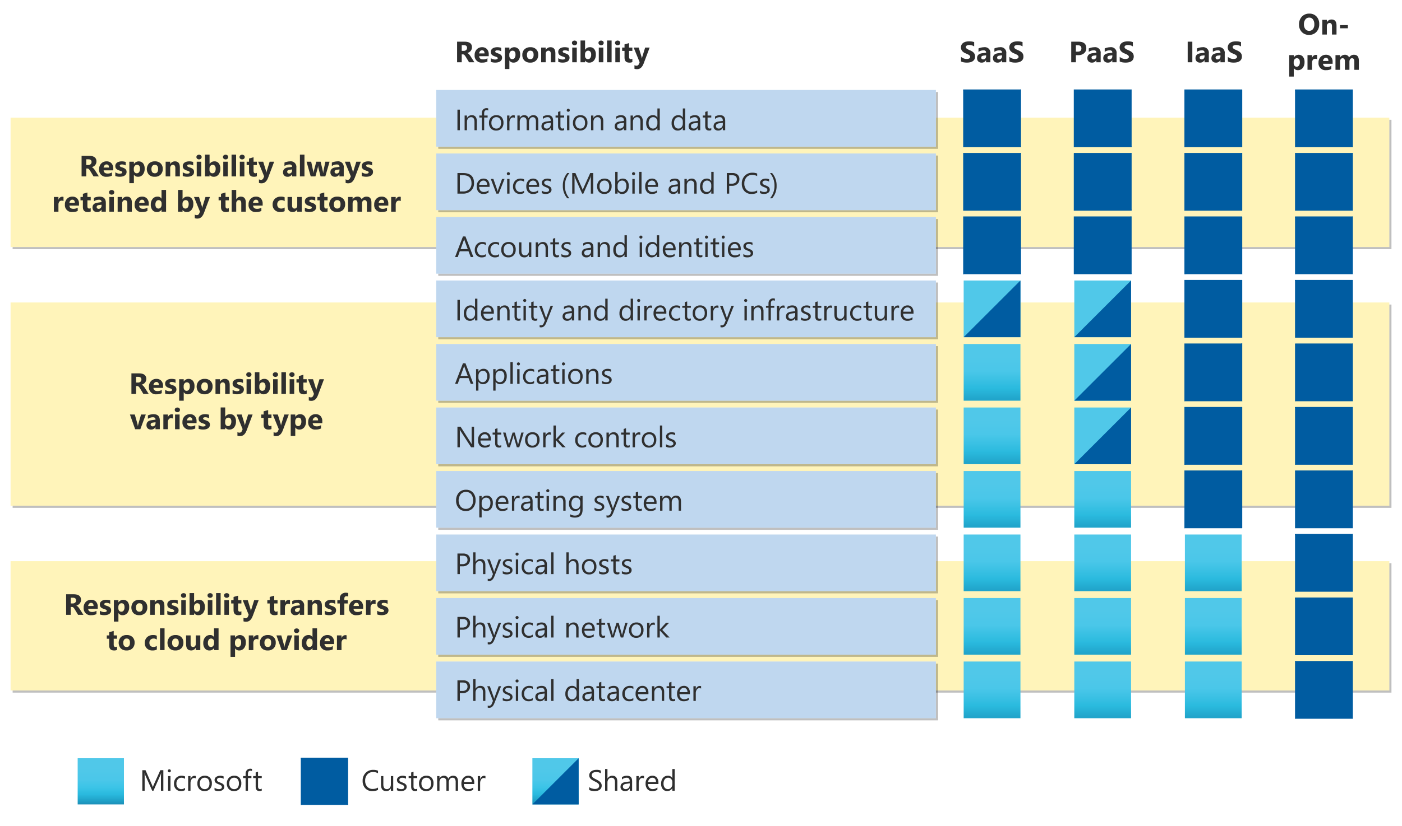

Slide 9
Defense in depth

Slide 10







• Full-blown distribution Amazon Linux 2 (AL2) vs.
container-optimized distribution
• Multi-tenancy requirements
• Gotchas: Linux packages / CVEs, leaks, GDPR (in Europe)
}
{
• Runtime / standards (OCI)
• Immutability of images
• All containers share a kernel (mitigation: Firecracker)
• Gotchas: unnecessary privileged users, no scans, trust
Host
Container
{
• Sensitive configuration (passwords, API keys, etc.)
• Gotchas: commits-to-source, non-separated access (dev. has cleartext password)
• Code analysis
• Source available?
• Gotchas: huge surface,
}
Dependencies
many languages
Source code
Configuration
}
• Sanitizing user input
• Static code analysis
• Gotcha: log-leaking
User data
{
• Business core data
• Personally identifiable information (PII)
• Gotchas: leaks, General
Data Protection Regulation (GDPR (in Europe))

Slide 11
Container security – Top 5

Slide 12
Container Image & supply chain security
Runtime Security
Host Security
Network Security
Access control & Auditing

Slide 13
Image Security

Slide 14
Create minimal images (docker-slim, alpine)
Reduce container attack surface area with purpose-built images
Reduce the number of layers in an image
Use a minimal base image such as Scratch, distroless, or a slim base layer
Eliminate binaries that are not needed at runtime
Remove access to containers shell environment
Multi-stage builds makes using scratch & distroless images easier

Slide 15
Create minimal images (docker-slim, alpine)
Reduce container attack surface area with purpose-built images
Reduce the number of layers in an image
Use a minimal base image such as Scratch, distroless, or a slim base layer
Eliminate binaries that are not needed at runtime
Remove access to containers shell environment
Multi-stage builds makes using scratch & distroless images easier

Slide 16
Lint your Dockerfiles (dockle, hadolint)
Scan container images
• Elastic Container Registry (ECR), Anchore, Clair, Trivy
Perform static code analysis & static application security testing before container image is created
Defang your images
• Remove files with the SETUID and SETGID bits from the imageAlways run as a non-root user
• Use endpoint policies and private endpoints with ECR
Mount secrets in memory at runtime, no sensitive data in image

Slide 17
Pod & Runtime Security

Slide 18
Use pod security policies (PSPs) or Open Policy Agent with Gatekeeper to implement runtime security measures
• Deny privileged escalation
• Deny running as root
• Deny mounting hostPath
• Drop Linux capabilities
Limit container resources using resource limits, namespace limit ranges & namespace resource quotas
Unless you specify a user, container will run as root – restrict root & privileged containers
Complement PSPs with AppArmor or Seccomp profiles
Use third-party solutions
• Aqua, Stackrox, Sysdig Falco, Twistlock

Slide 19
Host Security

Slide 20
Use an OS that is optimized for running containers
• EKS-optimized AL2 or Bottlerocket
• Atomic, Flatcar Linux, RancherOS
Deploy workers onto private subnets
Minimize and audit host access
• AWS Systems Manager, Session Manager
Run Amazon Inspector to continually assess alignment with best practices and compliance requirements
• kube-bench
• EKS CIS benchmarks
Use SELinux (RHEL and CentOS)
• Audit2Allow, Audit2Why, SEAlert
Encrypt all storage
Upgrade on schedule (features, deprecations, vulnerabilities)
Use tools to monitor & control syscalls like seccomp, AppArmor

Slide 21
Network Security

Slide 22
AWS Security groups around the container hosts
Amazon EKS security groups for pods
Allowing all traffic is the default policy
Use k8s network policies for restricting East / West traffic within the cluster
Start with a deny-all global policy and incrementally add policies
• Port 53 domain name system (DNS) egress to kube-system
^{• Allow all within a namespace}
Restrict outbound traffic from pods that do not need
to connect to external services
• Security groups for pods and cilium (L7 policies)
Encrypt service-to-services traffic with a mesh
• Alternatives: Select Container Networking Interface (CNI) plug-ins and Nitro instances

Slide 23
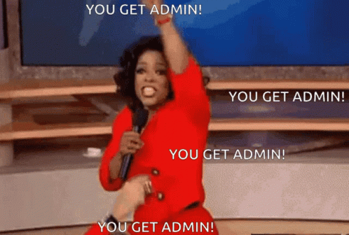
Identity & Access management

Slide 24
General guidelines IAM
• Practice the principle of least privilege for AWS IAM and Kubernetes Role Based Access Controls (RBACs)
• Configure EKS cluster endpoint to be private
• Periodically audit access to the cluster
• Use IAM roles for service accounts (IRSAs) to assign AWS identities to pods
If container must use AWS resources, then IAM roles, with fine grained policies should be used to control what resources a container can access
• Block access to EC2 metadata Kubernetes
Use Kubernetes RBAC & IAM to control API access
• Use separate services accounts for each application
• Disable mounting of the default service account (SA) token

Slide 25
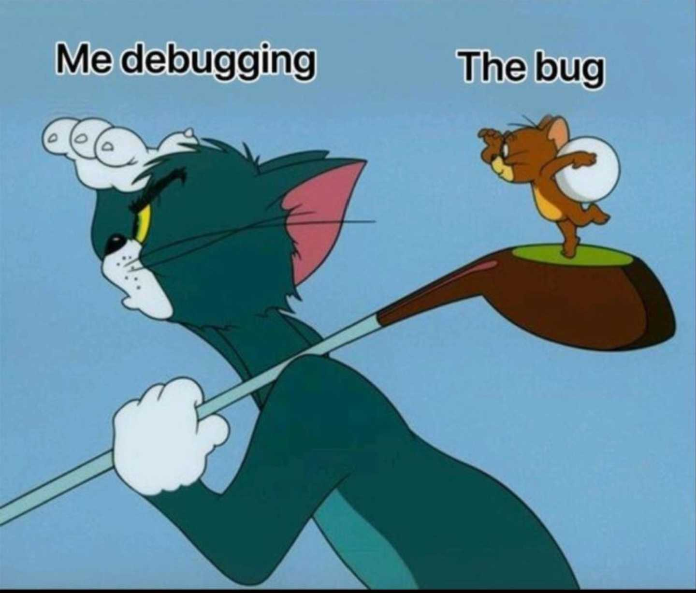
Auditing & Forensics

Slide 26
Enable control plane logs
Stream logs from containers to an external log aggregator
Periodically audit Kubernetes control plane and AWS CloudTrail logs for suspicious activity
• Search for the annotations authorization.k8s.io/decision and authorization.k8s.io/reason to ascertain why a call
was allowed / denied
Immediately isolate pods you suspect have been compromised
• Remove / change labels
• Create network policy to isolate the pod
• kube-forensics
Cordon the instance (if necessary)
• Capture volatile artifacts on the worker node, e.g., memory, disk, etc.

Slide 27
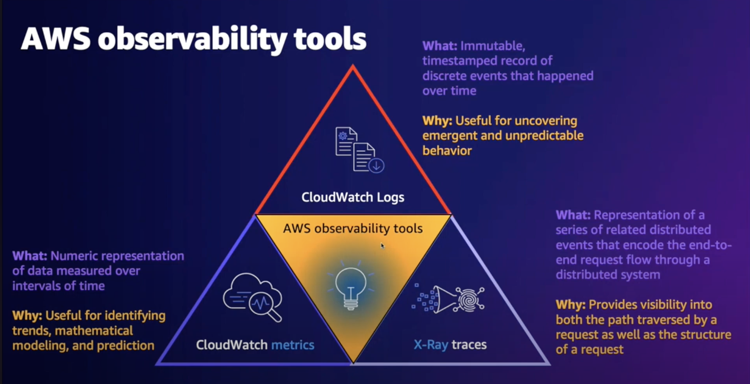
AWS Observability tools

Slide 28
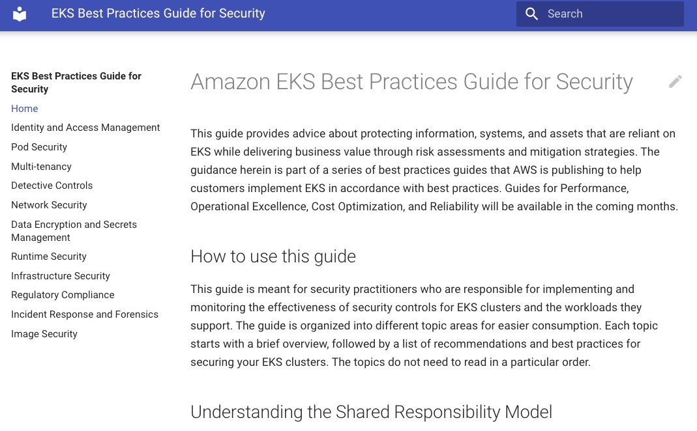
Amazon EKS best practices guide for security
https://aws.github.io/aws-eks-best-practices/

Slide 29
Closing thoughts
Security is everyone’s responsibility
Understand the shared responsibility model Shifting left and DevSecOps

Slide 30




Connect with me
https://www.linkedin.com/in/sagar-utekar/
https://twitter.com/me_sagar_utekar
https://github.com/Sagar2366

Slide 31


